Slide 1
Planet OS
Datathon Project

Slide 2




Table of Contents
Background
Analysis/Visualization
Conclusion
Questions

Slide 3
Agricultural Industry: Iraq
Agricultural industry performs poorly
67% of Iraq’s cultivatable area has been used for agricultural production.
Only 27% is currently suitable for agriculture due to limitations like drought, shortage of water, and unstable politics.
There is a shortage of labor in agriculture
People migrate to urban areas
Agriculture generates only 5%
of Iraq’s GDP, despite employing
20% of the labor force.
While the sufficiency of food supply decreases
The population in Iraq is increasing, doubling every year

Slide 4






Agricultural Industry: Syria
Syria has suffered a whopping $16 billion
in agricultural production losses after 6 years of civil war and the worst drought they’ve experienced in 900 years.
Rebuilding the Agricultural Sector
Water management & treatment
Depleted groundwater
As of April 2017, 9 of 10 families spend over half of their income on food.
Inefficient water use
Vaccination of livestock
Their agricultural industry remains resilient. With 17% of the workforce, it currently generates 21% of Syria’s GDP.
$11-17 billion

Slide 5
Table of Contents
Background
Analysis/Visualization
Conclusion
Questions

Slide 6
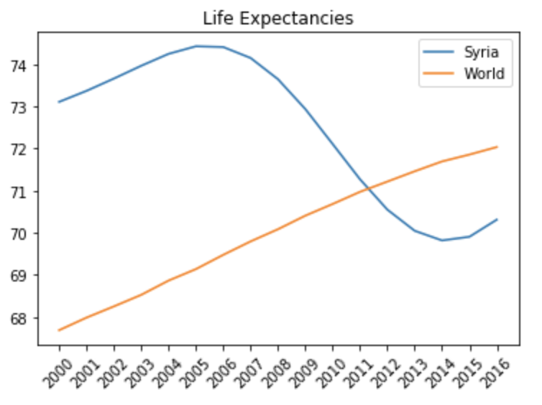

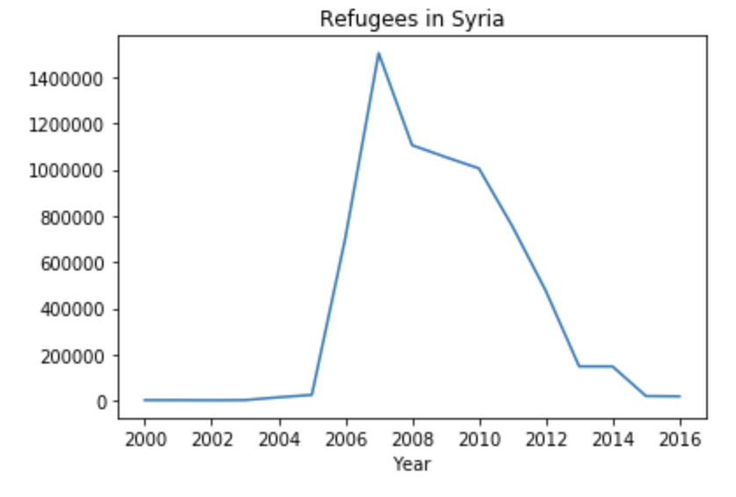
Syria suffered its worst drought in 900 years. Food was already becoming scarce as crops were failing, and the Syrian life expectancy began to plummet.
At the same time, the Lebanese War sent as many as 50,000 refugees across the border into Syria. Syrian households hosted refugees, but the agricultural production could not host the massive influx of people.
Data Exploration: Refugee Crisis
In 2006…
Drought
50,000 Lebanese war refugees
Decrease in agricultural production
Shortage of food
Shorter life expectancy
Syria’s life expectancy continued to decrease as the country launched into a civil war in 2011

Slide 7
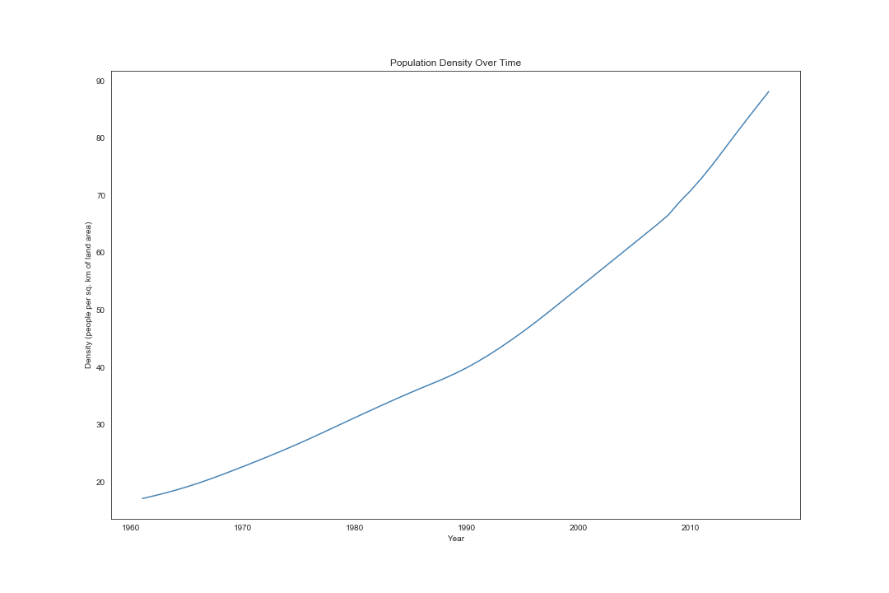
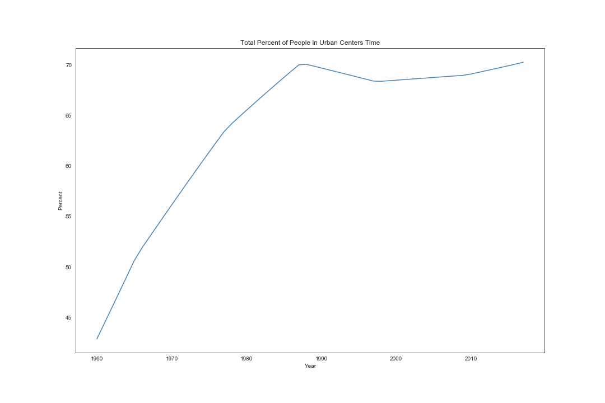
Data Exploration: Iraqi Migration
Key Takeaway
The number of people moving into urban areas (defined as 1 million+ in population) has historically been increasing until the 1990s (perhaps due to increase in regional conflicts), yet a steady exponential growth in population density is prevalent. This suggests heavy population growth and perhaps concentrating populations outside of urban areas.

Slide 8
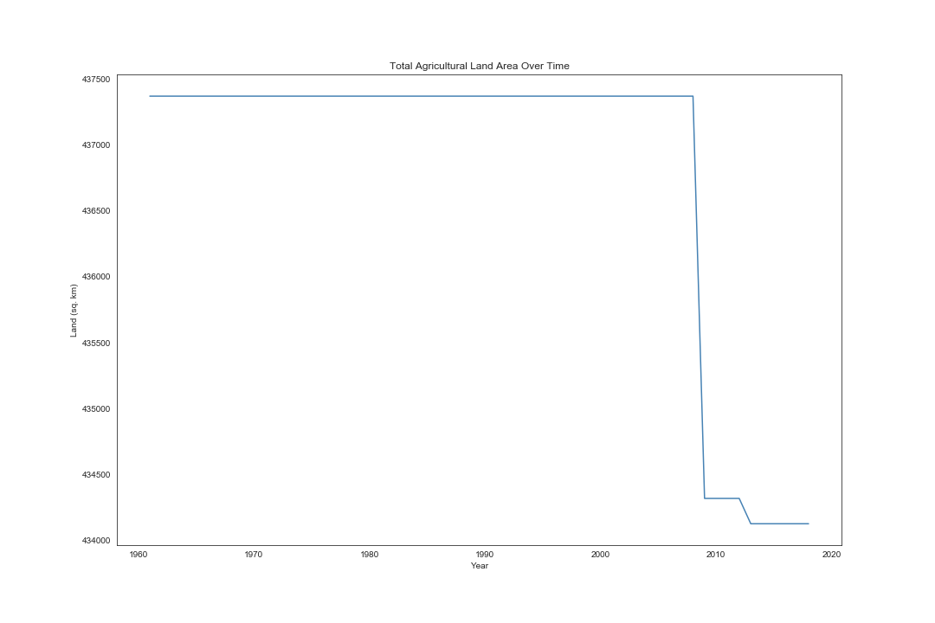
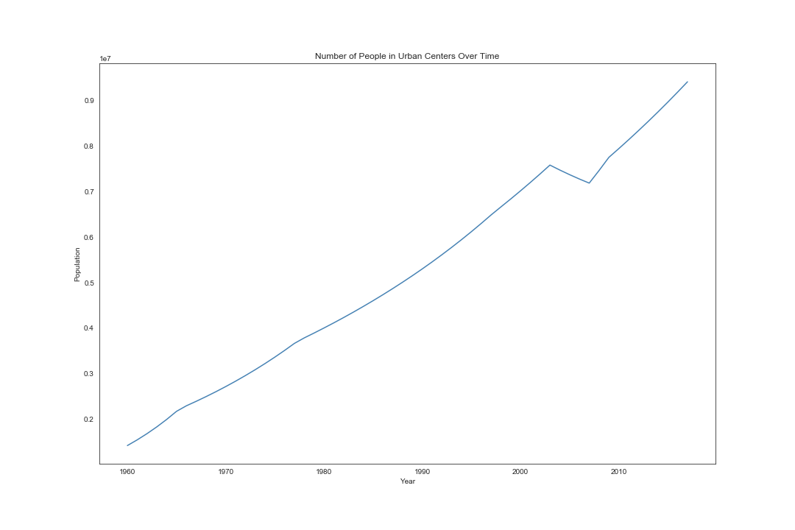
Data Exploration: Agriculture and Urban Population
Recall:
Agricultural industry performs poorly
There is a shortage of labor in agriculture
People migrate to urban areas
Not only are they losing labor, they are losing agricultural land as well. Meanwhile, the population density increases and the urban population grows.

Slide 9
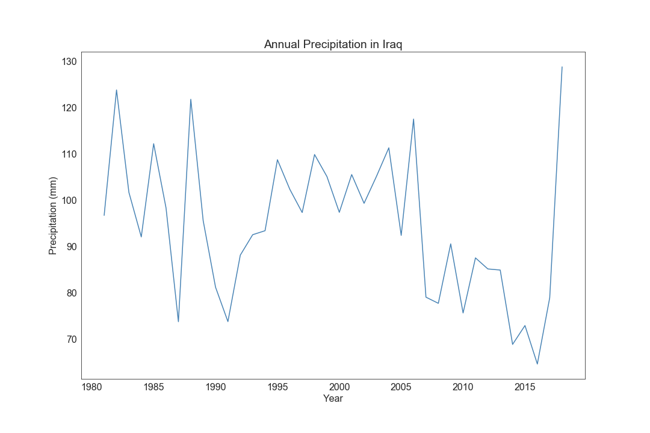
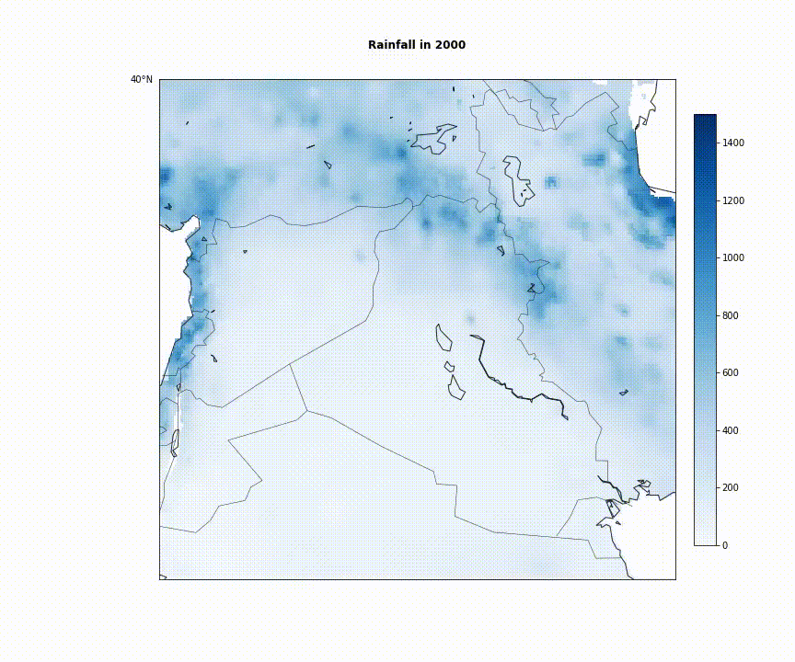
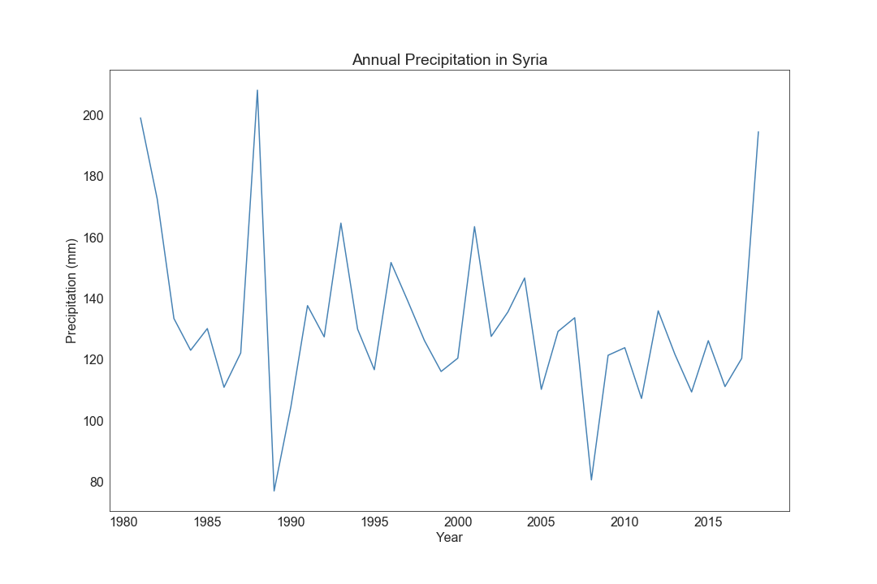
Rainfall Through Time

Slide 10
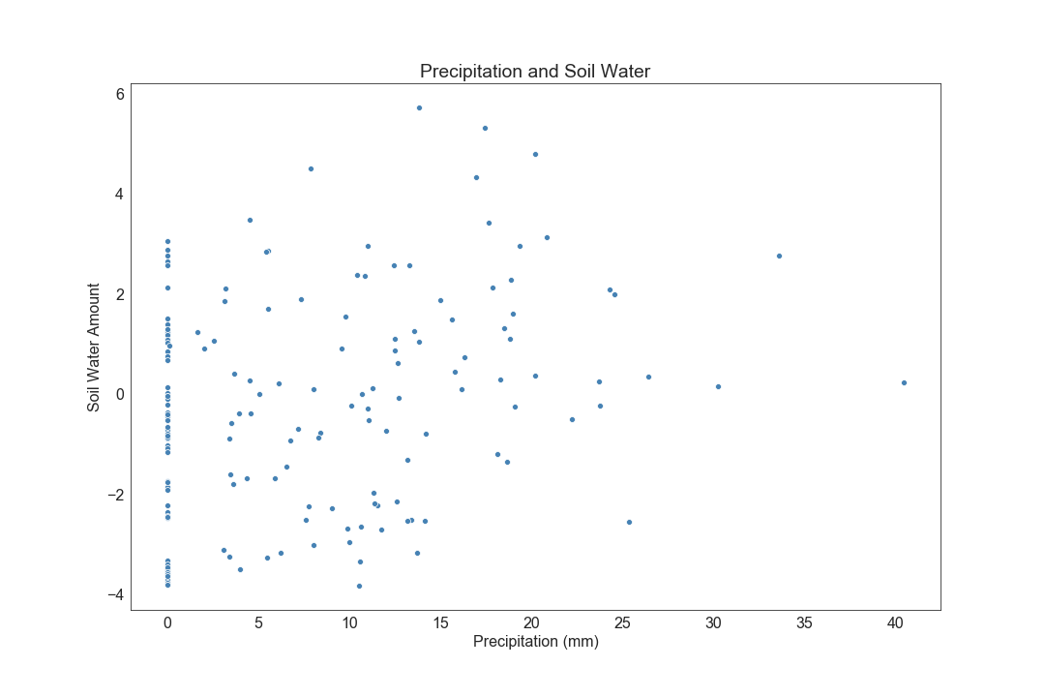
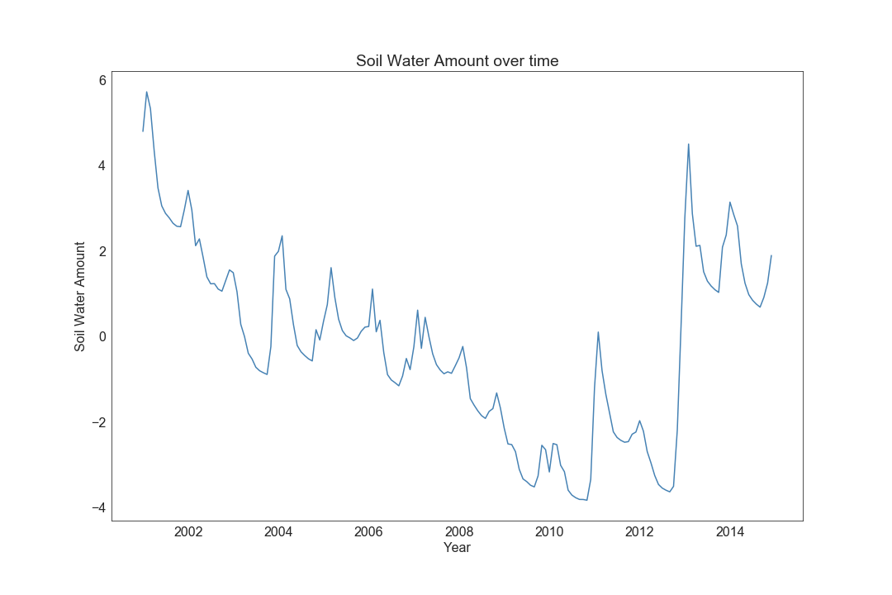
Rain and Soil
Key Takeaway
Since the drought in 2006, soil water content began a sharp decline, further lowering agricultural yields and fertile lands for farming. Here we can see a direct effect of the amount of rainfall affecting soil quality and how Syria suffered from all sorts of effects of a drought amidst the conflicts.

Slide 11
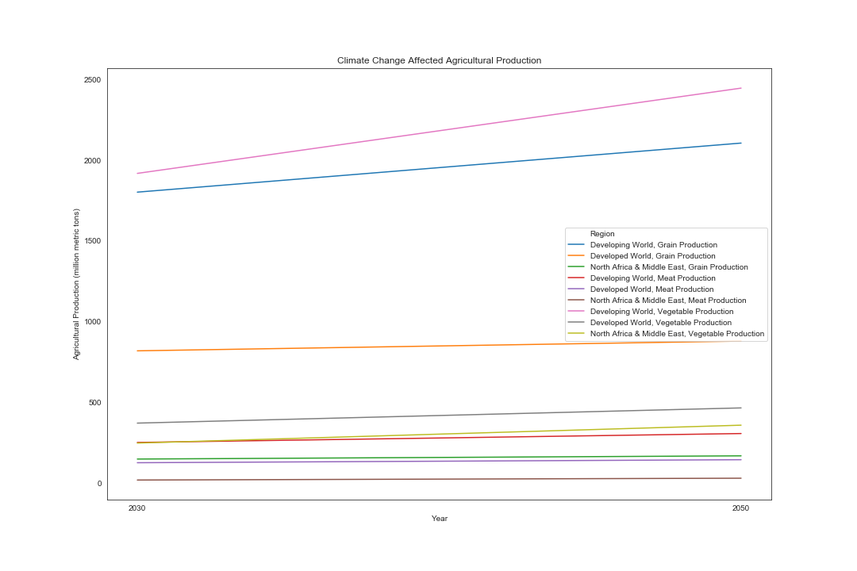
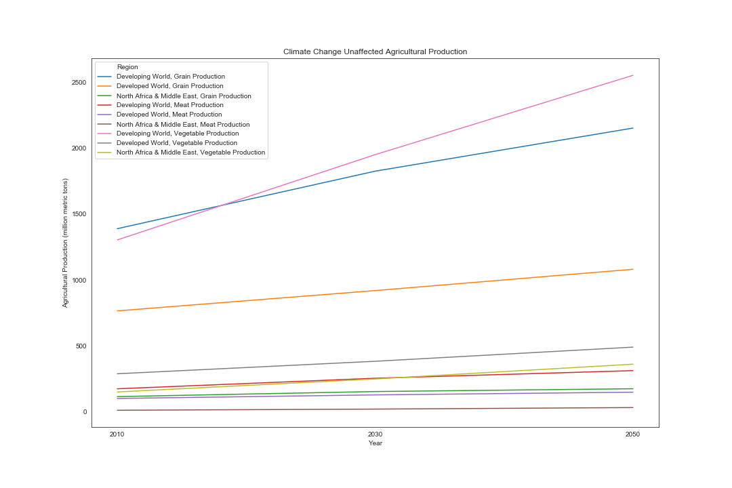
Food Predictions
Climate Change flattens growth across the board, but affects the developing world more than the developed world. This is a problem since developing nations have faster population growth and need to meet their demands. With less growth, this creates both an inequality between developing nations, including those of the Middle East, and the developed world, and inequalities internally, as access to resources usually favors those who are already well-off.

Slide 12
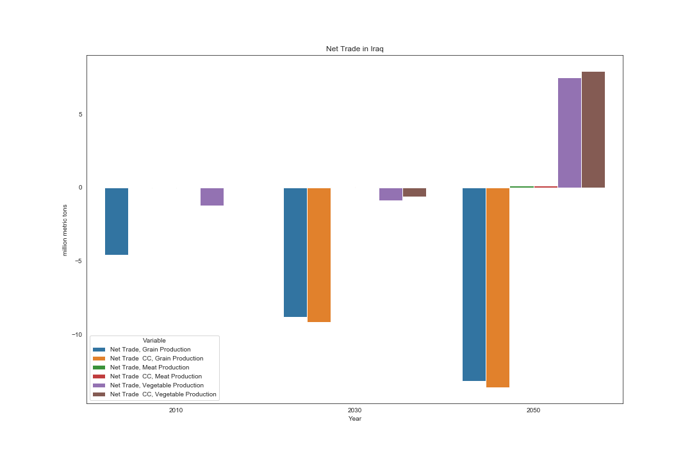
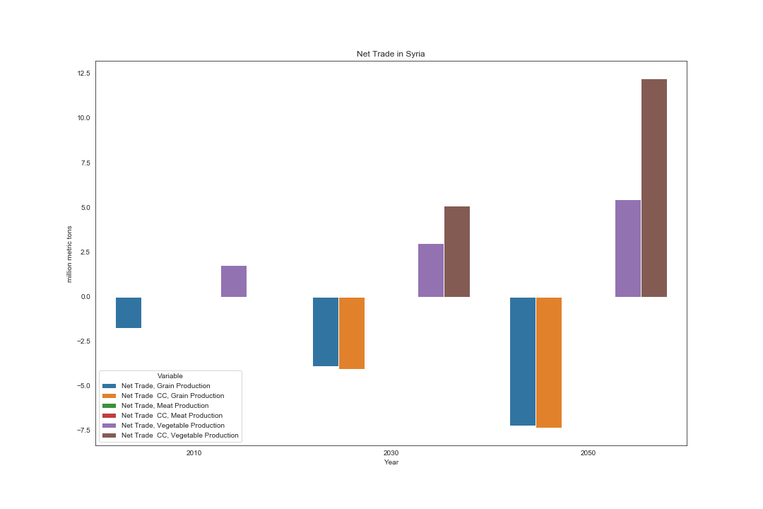
Net Trade
Climate Change exacerbates the production gap, forcing Iraq and Syria to increasingly rely on foreign aid and imports to support their ever-growing populations. This increased reliance on foreign agriculture may feed into inequality and social/political instability.

Slide 13
Table of Contents
Background
Analysis/Visualization
Conclusion
Questions

Slide 14
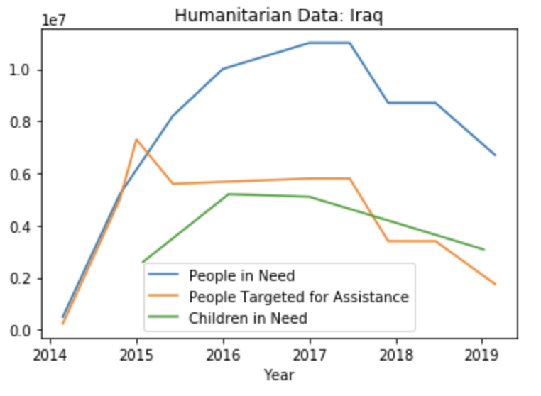
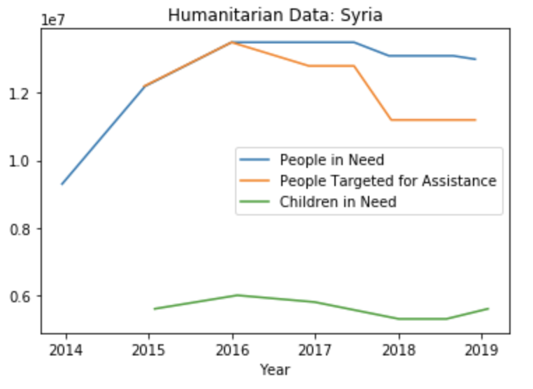
Conclusion/Insights
Tackling these environmental issues will no doubt be costly. The estimates of rebuilding Syria’s agricultural sector alone range from $11-17 billion.
Why is it so expensive?
Aside from the extensive damage by war and drought, many of their environmental issues are tied into their political state and economic well-being.
Each of these factors both cause and affect each other as they spiral into a positive feedback loop.
Why is current aid in Syria not working?
There is currently a $30 billion international humanitarian fund. However, Assad has gained control of the humanitarian response, using donor funds to skirt sanctions and fund war efforts.

Slide 15
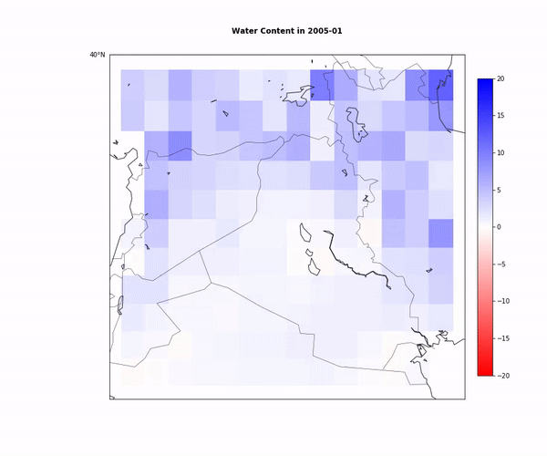
Conclusion/Insights
To summarize:
As the exponential growth in population density is coupled with climate change, food production decreases and the reliance on foreign aid increases. This contributes to both internal and external inequality between the countries in that area, which then fuels social, political, and economic instability.
Food production is decreasing because the agricultural sector is so reliant on rainfall and soil quality, both of which are suffering from environmental conditions and violent conflict in the area. The visual on the right shows the decline in soil quantity from 2005 to 2014.

Slide 16
Table of Contents
Background
Analysis/Visualization
Conclusion
Questions

